Slide 1
DocuSign Create Envelope
HLUS IT
04/06/2020

Slide 2
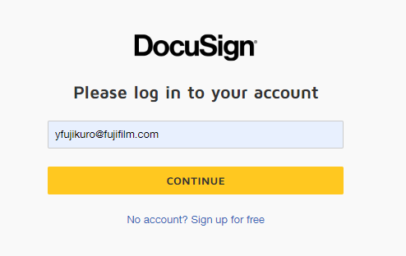
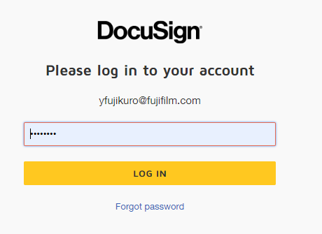
1. Log In
Go to below URL:
https://account.docusign.com/
Enter email address.
Enter Password.

Slide 3
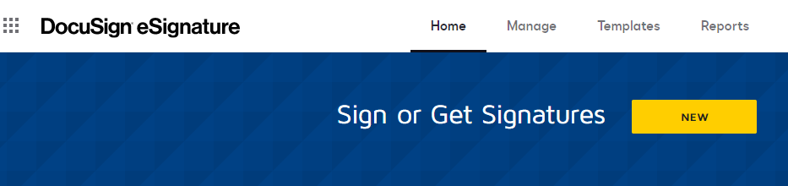
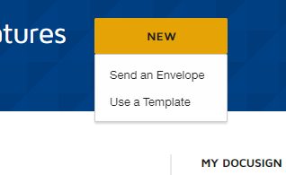
2. Start An Envelope
Click on “New” button.
Click on “Send Envelope” button.

Slide 4
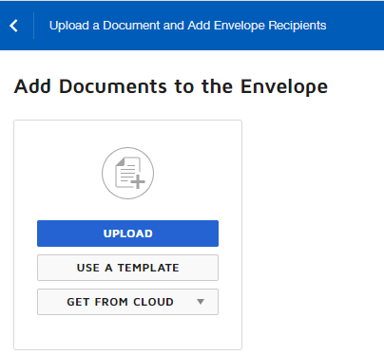
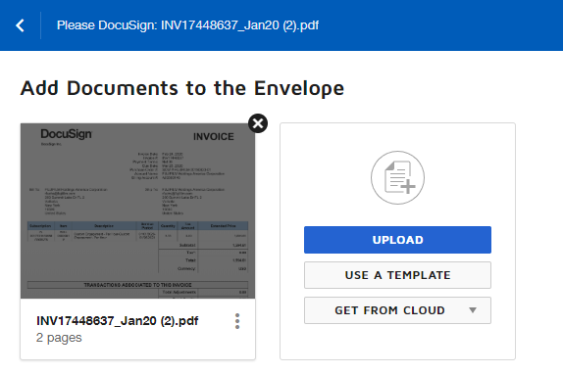
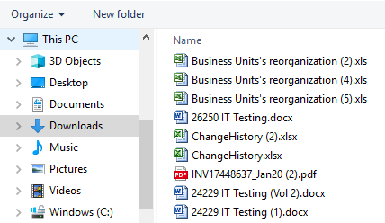
3. Upload Documents
Click on “Upload” button and select the document to be uploaded.
Repeat this step until all the documents to be signed are uploaded.

Slide 5
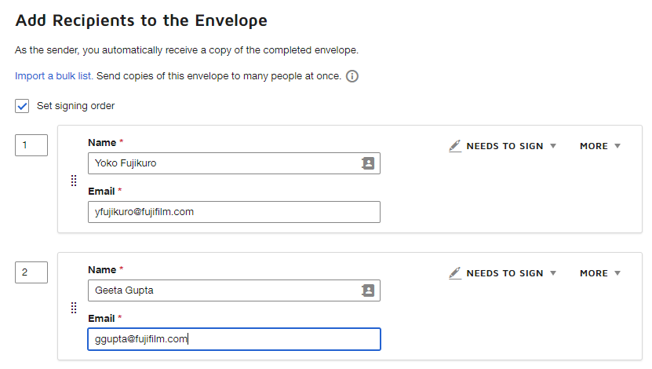

4. Add Recipients
After documents are uploaded, scroll down to add recipients/signers.
If an envelope needs to be signed in a certain order, check in “Set signing order”. Then, enter signer’s name and email address. Click on yellow “Next” button.

Slide 6
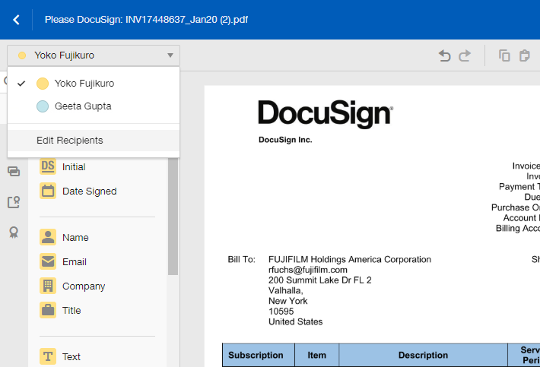
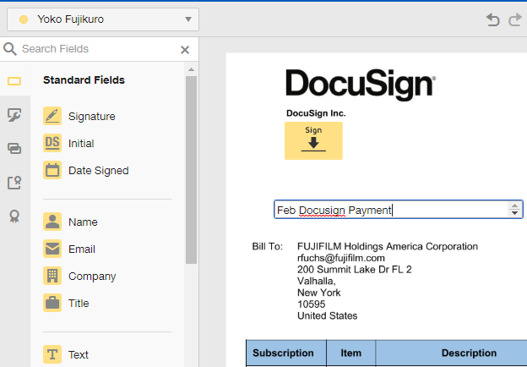
5. Add Digital Signature Field
Select the first recipient. Drag and drop the signature field to the document. This is where your recipient will be signing. If a note needs to be added, drag and drop the text field and enter the note.

Slide 7
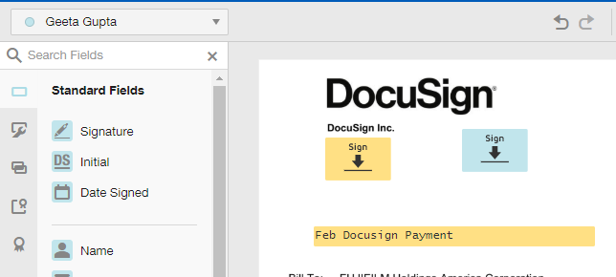

6. Add 2nd Digital Signature Field
Set up the signature field for the 2nd recipient, and so on.
Click on yellow “Send” button. The document will be sent to the recipients.

Slide 8
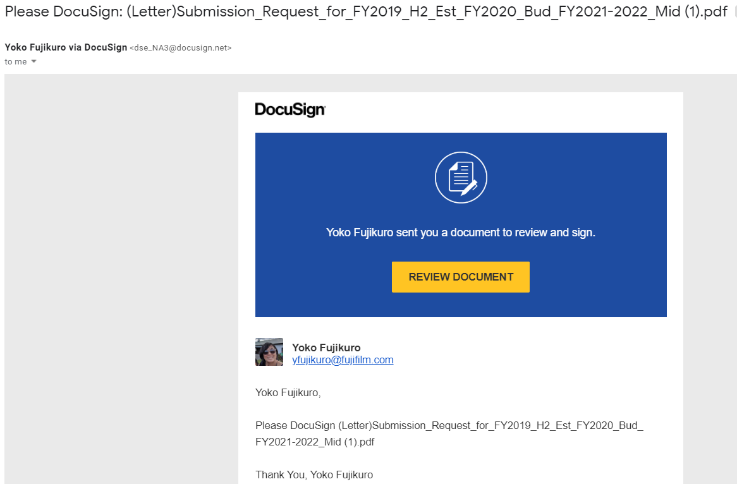
7. Notification to Recipient
The envelope recipient will receive an email as seen above.

Slide 9
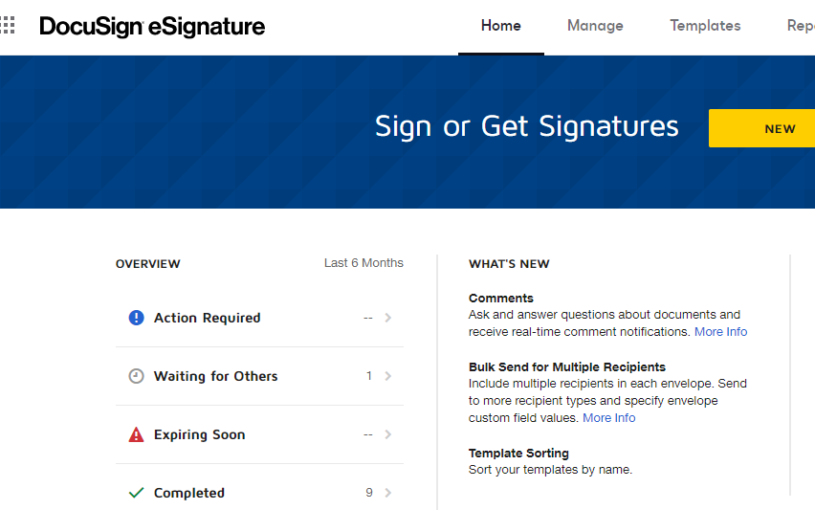
8. Envelope Status Check
The status of each envelope can be checked from Overview section of the main page.

Slide 10
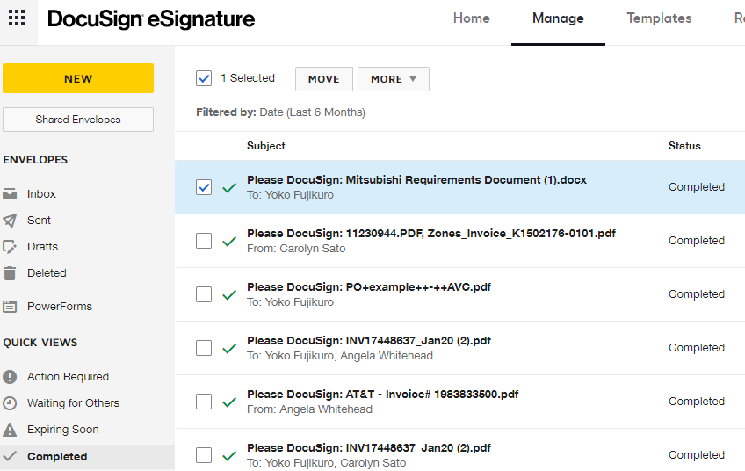
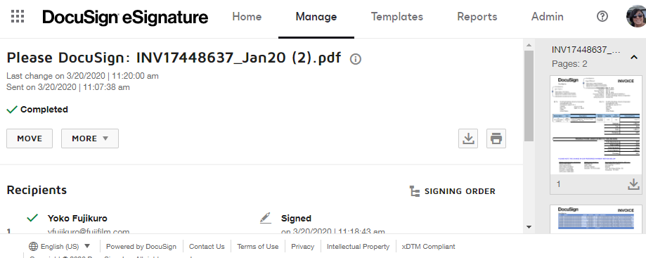
9. Download the Document
From main screen, go to Overview and click on “Completed”.
Select the document to be downloaded.
Click on download icon on the right top area.

Slide 11
10. Additional Resources
DocuSign Support
https://support.docusign.com/en/home
IT Contact Info:
Katie Alberti: katie.alberti@fujifilm.com

